Slide 1
Text Summarization
Kiel Rotz
Springboard Data Science Capstone
December 2021

Slide 2
What is text summarization?
Text summarization is the method of extracting summaries from original text without losing any vital information
It is typically grouped into two categories of methods: Extractive & Abstractive
Extractive summarization seeks to identify the most significant sentences of the text and use them to create a summary.
Thus, the summary contains the exact sentences from the original text.
Abstractive summarization seeks to identify the important sections and interpret the context in order to generate sentences for the summary.

Slide 3
Our Goals
To explore the current state of text summarization and compare different models and different approaches.
To give a guided walkthrough of building a text summarization model for both an extractive and abstractive approach, and to compare various pre-built and pre-trained models.
To give a brief introduction in how to compare text summarization models.

Slide 4
The Data from Kaggle website
Original data features
Pre-processed data features
wiki_movie_plots_deduped.csv
Release Year, Title, Origin/Ethnicity, Director, Cast, Genre, Wiki Page, Plot
movies_metadata.csv
adult, belongs_to_collection, budget, genres, homepage, id, imdb_id, original_language, original_title, overview, popularity, poster_path, production_companies, release_date, revenue, runtime, spoken_languages, status, tagline, title, video, vote_average, vote_count
df_final.csv
Release Year
Title
Plot
Overview
cleaned_plot
cleaned_overview

Slide 5
Data preprocessing
Loaded and merged the two csv files
Dropped all unnecessary columns
Created the cleaned_overview and cleaned_plot columns by:
Convert everything to lowercase
Remove HTML tags
Contraction mapping (Don’t → do not)
Remove possessives (-’s)
Remove text inside parenthesis
Eliminate punctuations and special characters
Remove stopwords
Why is it necessary to preprocess in NLP?
Machine learning algorithms perform better if the text is given in a more digestible form.

Slide 6
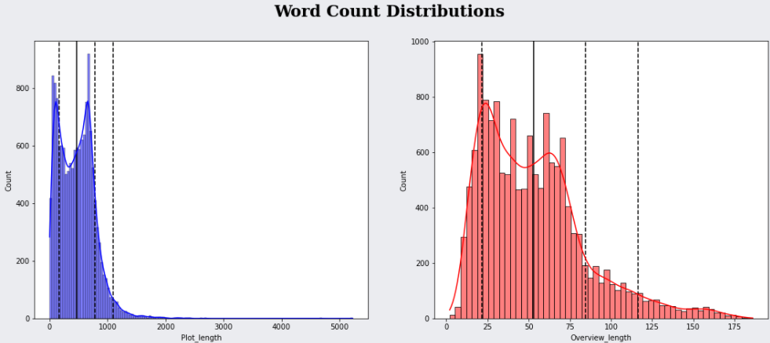
Data Exploration and trimming
Plots greater than 600 words and overviews greater than 125 words were cut.
The extreme outliers would have been cut anyway to help the models learn better, but most importantly we needed to trim to ease the computational burden on the computer.

Slide 7
Evaluation Metrics
Human Subjective evaluation
Cosine similarity
measures how similar two documents are regardless of their size by using the cosine of the angle between two vectors projected in a multi-dimensional space.
advantageous because even if the two documents are far apart in their Euclidean distance (because of the difference in document sizes), they may still be oriented close together.
ROUGE scores

Slide 8
ROUge scores
ROUGE is a set of metrics comprised of a ROUGE-N (ROUGE-1, ROUGE-2, etc.) and ROUGE-L, both of which have a recall, precision and F1 score.
ROUGE-N: Measures the number of matching 'n-grams' between generated text and the reference text.
ROUGE-1 measures the matching number of unigrams (1 token/word). ROUGE-2 measures the matching number of bigrams (2 consecutive tokens/words).
Recall: counts the number of overlapping n-grams found in both the model output and reference divided by the total number of n-grams in the reference.
This ensures our model is getting all the information in the reference, but does NOT ensure our model isn't just producing a large number of words to improve the recall score.
Precision: counts the number of overlapping n-grams found in the model output and reference, and then divides this by the model n-gram count (rather than the reference n-gram count).
essentially measures how much of the output of the machine generated summary was in fact relevant or needed. This helps us to avoid the problem with recall mentioned above. Thus, precision is crucial when you are trying to generate summaries that are concise rather than verbose.
F1: The best of both worlds, F1 is 2 * ((precision * recall) / (precision + recall)).
ROUGE-L: measures the LCS (longest common sequence) of tokens between the model output and the reference.
the idea is that a longer shared sequence indicates more similarity.
Recall, Precision and F1 are used just as before but instead of matched n-grams we use LCS as the numerator.

Slide 9
Extractive models
Spacy:
Utilizes TF-IDF (Term-Frequency-Inverse Data Frequency) to weigh the importance of each sentence
TF: measures how frequently a term occurs in a document (divided by document length)
IDF: measures how important the term is.
Each sentence will be weighed based on the frequency of the token present in each sentence.
LSA (latent semantic analysis): From the sumy library
An unsupervised method that combines term frequency techniques with SVD (singular value decomposition).
SVD can identify the patterns of relationships between the terms
Based on the principle that words which occur in the same contexts tend to have similar meanings
Computes a set of matrices which give the similarity between the documents
Luhn: from the sumy library
Also utilizes TF-IDF, but it assigns higher weights to sentences occurring near the beginning of a document.

Slide 10
Abstractive Models

Slide 11
Encoder-Decoder Seq2Seq RNN (walkthrough)
RNNs usually have fixed size input and output vectors. This is obviously quite undesirable for machine translation.
Seq2Seq models can help us solve this problem. How?
Because the fixed size output vector generated by the encoder need not be the same size as the input vector given to the decoder.
It can be passed in whole or can be connected to the hidden units of the decoder unit at every time step.
our model has an encoder that accepts the pre-processed Plot and Overview, trains the model to create an encoded representation, and sends it to a decoder which decodes the encoded representation into a reliable summary.
With more and more training, the model can be used to perform inference on new texts to generate new summaries.

Slide 12
Transformers library (pre-trained)
Transformers represented a huge step up in text summarization
The biggest benefit comes from how the transformer lends itself to parallelization.
Unlike RNNs, transformers do not require the sequential data to be processed in order.
This, among other things, drastically reduces training times.
We will look at 2 implementations of transformers from the hugginngface's transformers library, T5 and Bart.
Each is a pre-trained model with its own architecture and weights.

Slide 13
Transformers library (pre-trained)
T5
T5 is pre-trained on a multi-task mixture of unsupervised and supervised tasks and for which each task is converted into a text-to-text format.
It uses relative scalar embeddings and encoder input padding can be done on the left and the right.
BART
BART is a denoising autoencoder for pre-training seq2seq models.
uses both BERT (bidirectional encoder) and GPT (left to the right decoder) architecture.
As described by huggingface, BART is trained by:
(1) corrupting text with an arbitrary noising function, and
(2) learning a model to reconstruct the original text.
BART does well on many tasks like abstractive dialogue, question answering and summarization.
It is trained on the CNN/Daily Mail data set

Slide 14
Results

Slide 15
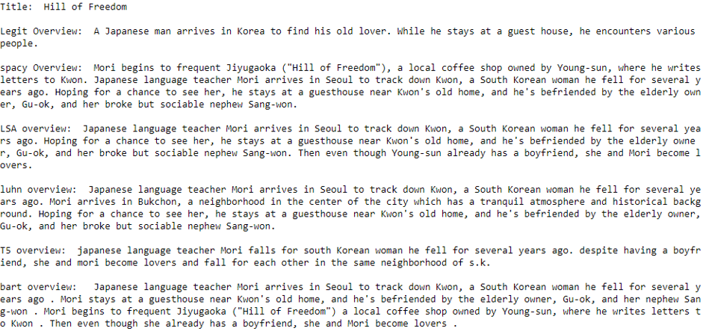
Subjective analysis

Slide 16
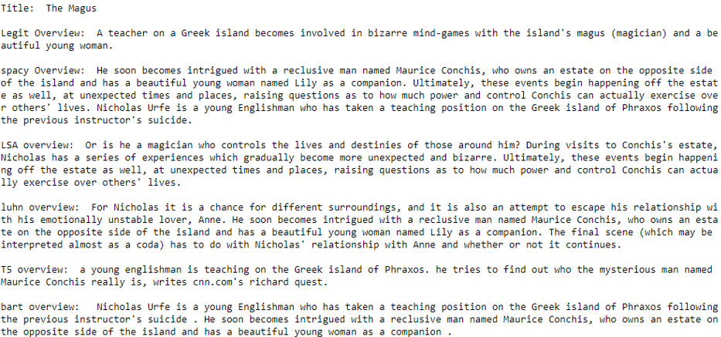
Subjective analysis (cont’d)

Slide 17
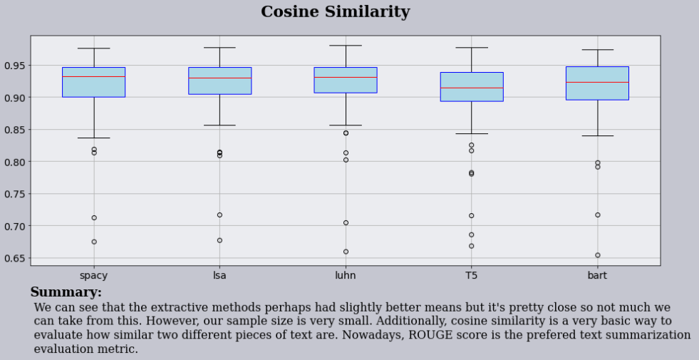
Cosine similarity

Slide 18
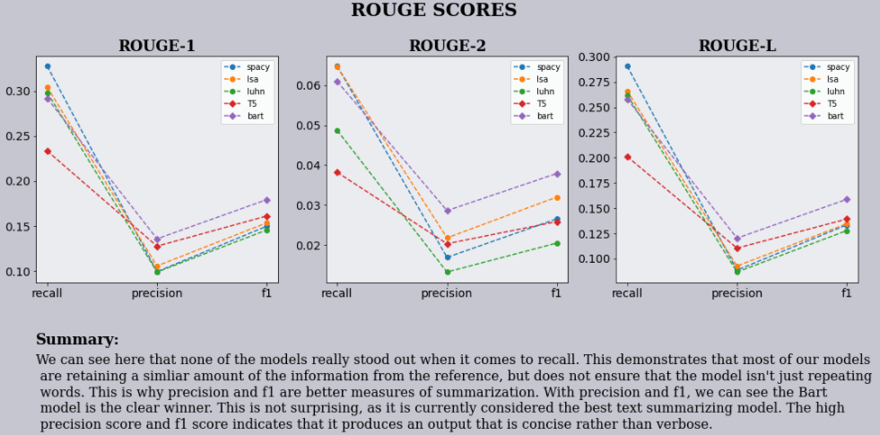
Rouge scores

Slide 19
Summary
the extractive approaches do similarly to the abstractive approaches with cosine similarity.
This is likely because the extractive approach literally lifts full sentences from the original text.
With the ROUGE scores, the clear winner is the Bart model.
It has by far the highest precision and f1 scores for all three ROUGE scores.
Spacy does notably well with recall, but poorly in precision and f1.
the real test is the human subjective test.
With the extractive approaches, it is pretty hit or miss if the generated summary is actually able to capture the essence of the original plot
because they use fully lifted sentences, most of the sentences of the generated summaries do not flow into one another naturally. They all seem out of place. This is where the abstractive methods really shine.
the abstractive models, although not perfect, do well to capture the essence of the plot in a concise manner and the sentences flow much more naturally into each other
Overall winner: Bart
It is perhaps hard to choose between T5 and Bart by comparing summaries alone, but along with the objective scores, it seems Bart is the clear winner here.

